Slide 1

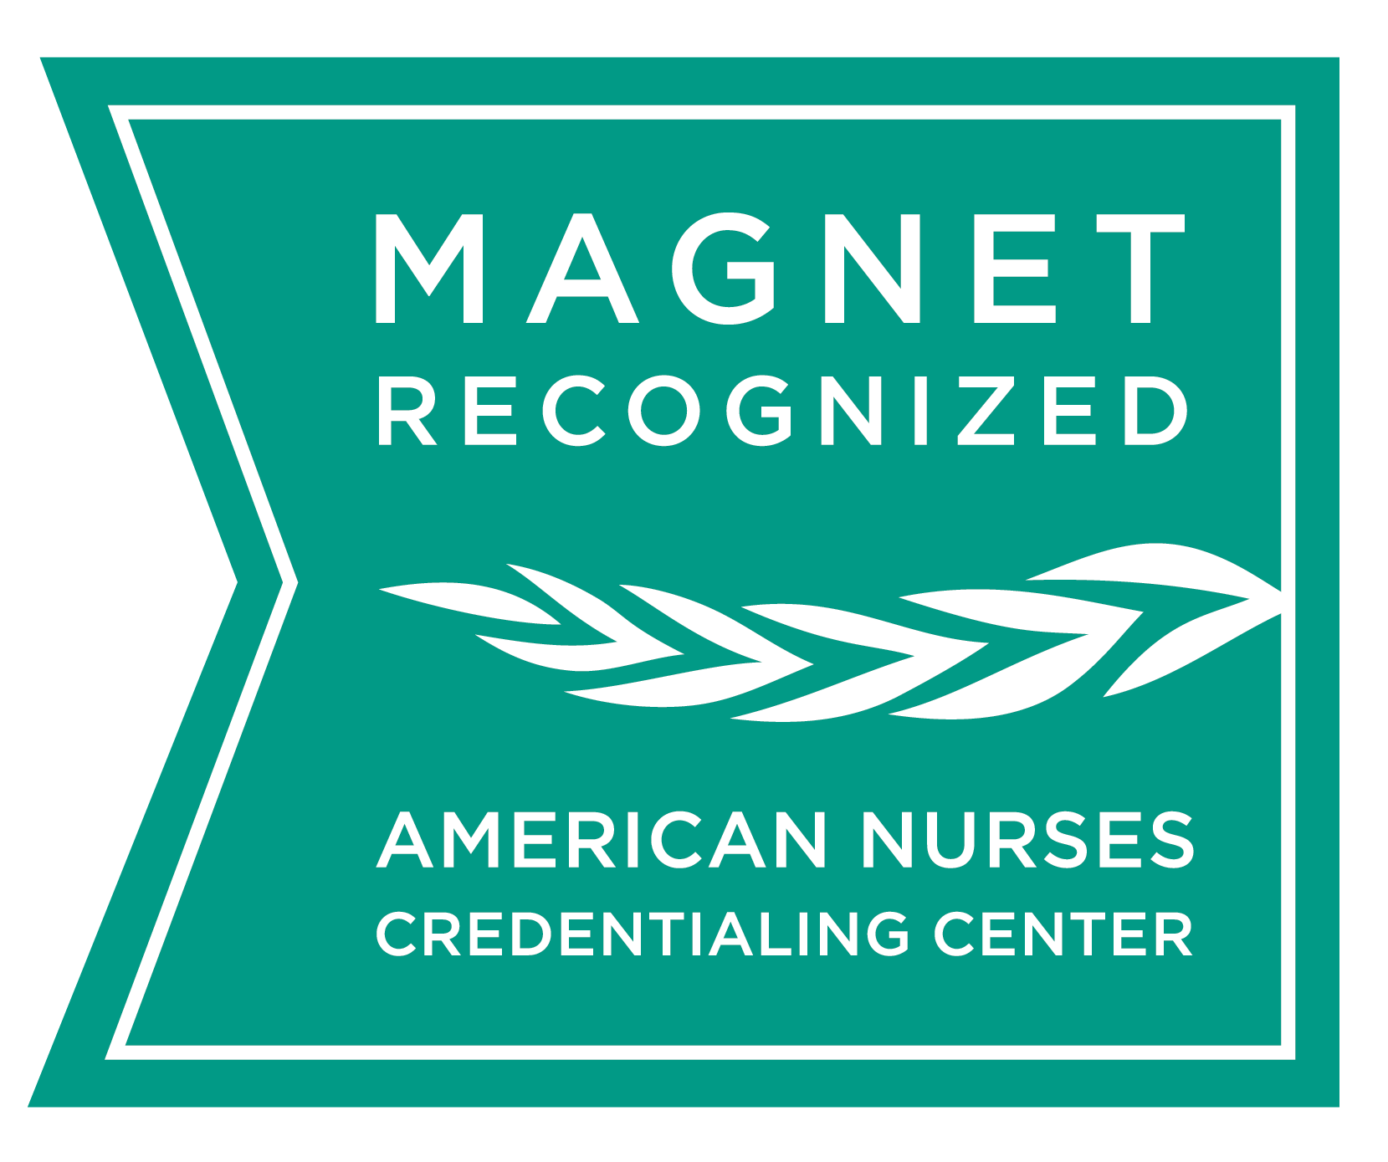
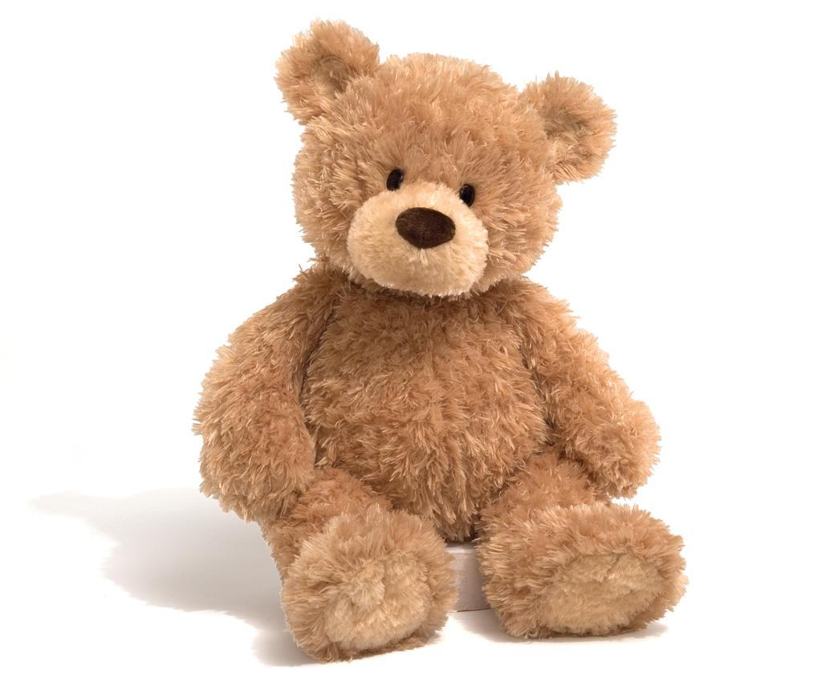
Bearing the Weight of Loss
Preventing Empty Arms Syndrome in the NICCU
Cassie Anglin, BSN, RN, Brooke Bennett, BSN, RN, Leslie Blackwelder, BSN, RN,
Summer Escorcia, BSN, RN, Meghan Firth, BSN, RN, and Elisabetta Impagliazzo, BSN, RN
Children’s Hospital Los Angeles
Purpose
Literature Review
Barriers and
Future Goals
Providing parents with a weighted teddy bear has the potential to decrease the incidence of Empty Arms Syndrome and also family satisfaction with NICCU bereavement services.
Giving caregivers an infant-sized object to carry has been shown to lead to relief of heaviness in the chest and aching arms, as well as diminishing psychological suffering. About 600 bears are distributed across the United States each year by the Comfort Cub Program to parents who experienced an infant loss, which is only one of many established “weighted teddy bear” programs in the U.S. (Johnson, Moore, & Ferris (n.d.)
Raitio, Kaunonen, and Aho (2015) evaluated the effectiveness of a bereavement follow-up intervention for grieving mothers after the death of a child. The study showed no difference in grief reduction between the control group and intervention group, but mothers in the intervention group reported increased effectiveness of coping and increased personal growth post intervention.
Kavanaugh and Hershberger (2005) emphasized the importance of “creating and cherishing” memories of the infant in cases of infant loss, particularly the importance of holding infants. While this study does not use a weighted teddy bear in the process of bereavement in perinatal loss, the importance of holding in these moments could be used to support the belief that an item to hold may ease pain and grief and create greater satisfaction with bereavement care.
A study exploring emotional symptoms and physical health of bereaved parents done by Miles (1985) showed higher rates of somatization, anxiety, depression, interpersonal sensitivity, and obsessive compulsion in bereaved parents than in non-bereaved parents.
According to Fanos, Little, and Edwards (2009), little is known about the consequences of an infant loss on the siblings. Not only does it have a significant impact on the parents, but it also influences the siblings who were alive or even born after the infant death occurred. Infant death as well as the parental response can lead to anger, guilt, sorrow, helplessness, and depressive symptoms for siblings. These weighted bears are not limited to parents, but are encouraged to be used throughout the family.
Barriers
Difficulty following up with parents post infant demise to measure the impact of the bears
Lack of research done on the use of weighted bears and their outcomes
No baseline data has been collected on services prior to implementing the bears in the NICCU
Future Goals
Introduce use of bears for parents of infants with critical airways
Implement use of bears throughout the hospital for families experiencing a loss
Monitor family satisfaction with bereavement services at CHLA and occurrence the “Empty Arms Syndrome” in families.
Background
Projected Survey
Results
Conclusions
The Steven & Alexandra Cohen Foundation Newborn and Infant Critical Care Unit (NICCU) is a level IV, 58-bed critical care unit at Children’s Hospital Los Angeles. In 2016, 27 out of 677 infants passed away in the NICCU. Current bereavement services consist of preparing pictures, molds, and hand or footprints of the infant, along with providing a comfort care basket and infant clothing to the family. Psychological and Spiritual Care Services are resources provided to families as needed. Research shows that bereaved families can experience a phenomenon known as “Empty Arms Syndrome.” Empty Arms Syndrome is described as a void felt after the loss of a child; it is not currently accounted for in the NICCU bereavement services. Providing families with a weighted teddy bear has the potential to decrease the incidence of this syndrome and also increase familial gratitude of bereavement services provided.
NICCU Patient Data
The weighted teddy bears are expected to increase family satisfaction with our bereavement services and decrease the prevalence of “Empty Arms Syndrome” among families.
Through the implementation of the Weighted Teddy Bear project, we hope to provide similar comfort to the families in the CHLA NICCU who have lost their children too soon.
With the implementation of the weighted teddy bear, we believe that our families will have similar responses as shown below:
“I have witnessed first-hand what these therapeutic bears have done to lessen the heartache and aching empty arms of a grieving mother, the tenderness with which they are held reveals the indescribable meaning they have in the grieving heart.” (Liz Sumner, Director, The Center for Compassionate Care, n.d.)
“Bradley David Lynch 2lbs 13oz. That’s how much he weighed when he was born and that’s exactly how much this very special bear weighs. Thanks to Molly bears I now know what it would feel like to hold Bradley and to have this with me the rest of my life is priceless.” (onemotherofaday, 2016)
“Holding the bear made me feel instantly safe & has made my arms not quite so empty anymore.”
(Jenna K., Billings, MT, n.d.)
“We lost our precious princess and my nurse gave me one of your bears after I gave birth to her. When my 2 yr. old son asked about his sister we told him that she left him the bear before becoming an angel in heaven. He sleeps with his bear every single day.”
(Projectbear.com, 2016)
Acknowledgments
Thank you to the NICCU staff, the Family Centered Care Committee, and the Comfort Care Committee for their input. Thank you to Sue Bugsch, Brenda Barnum, Erin Mounger, and Sandy Hall for their guidance. Thank you to Amber Blackwell for the inspiration for this project.
Conducted a literature review to identify new practices that have the potential to improve parent experience during bereavement. Searched terms include “bereavement,” “infant loss,” and “nicu.”
Reviewed data gathered from current weighted teddy bear programs in comparable institutions to collect projected survey results.
Consulted with the Family Centered Care and the Comfort Care Committees to determine the current needs of bereaved families in the NICCU.
Methodology
References
Fanos, J. H., Little, G. A., & Edwards, W. H. (2009). Candles in the Snow: Ritual and Memory for Siblings of Infants Who Died in the Intensive Care Nursery. The Journal of Pediatrics, 154(6), 849-853. doi:10.1016/j.jpeds.2008.11.053
Johnson, M., Moore, T., & Ferris, FD (n.d.). The Therapeutic Use and Impact of the Comfort Cub Program In Perinatal Bereavement. Institute for Palliative Medicine at the San Diego Hospice. Retrieved from thecomfortclub.com
Kavanaugh, K., & Hershberger, P. (2005). Perinatal Loss in Low-income African American Parents: The Lived Experience. Journal of Obstetric, Gynecologic, and Neonatal Nursing : JOGNN / NAACOG, 34(5), 595–605. http://doi.org/10.1177/0884217505280000
Miles, M.S. (1985). Emotional symptoms and physical health in bereaved parents. Nursing Research, 34 (2), 76-81.
Raitio, K., Kaunonen, M., & Aho, A. L. (2015). Evaluating a bereavement follow-up intervention for grieving mothers after the death of a child. Scandinavian Journal of Caring Sciences, 29(3), 510–520. doi:10.1111/scs.12183

