Slide 1
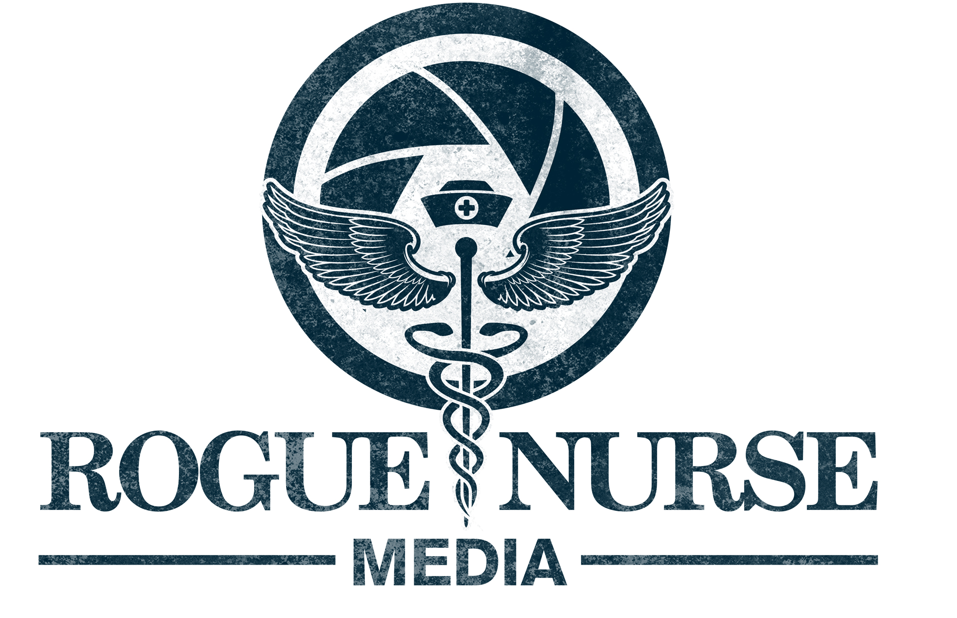
Are You A Rogue Nurse?
Empowering Nurses And Patients Through: Art + Media + Technology
Ersilia Pompilio RN, MSN, PNP
Creator / CEO Rogue Nurse Media 501c3

Slide 2

Disclosures
I have no potential or actual conflicts of interest all opinions shared are my own!

Slide 3
Objectives
1. Better understanding of the use of ART + Media+ Technology in patient care
2. Explain the importance for CREATIVE thinking in clinical practice and why it shuts down
3. Demonstrate at least 3 CREATIVE techniques that you can use in clinical practice to EMPOWER patients co-workers, and yourself!

Slide 4
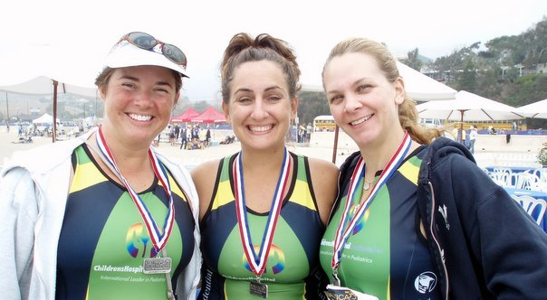
What’s A Rogue Nurse?

Slide 5


Slide 6


Slide 7
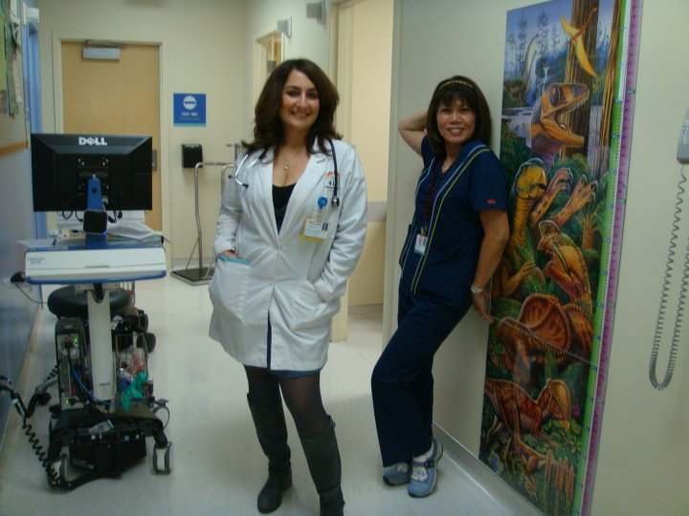

Slide 8
#3 FOOD
1. Out of The Box
2. Creative

Slide 9
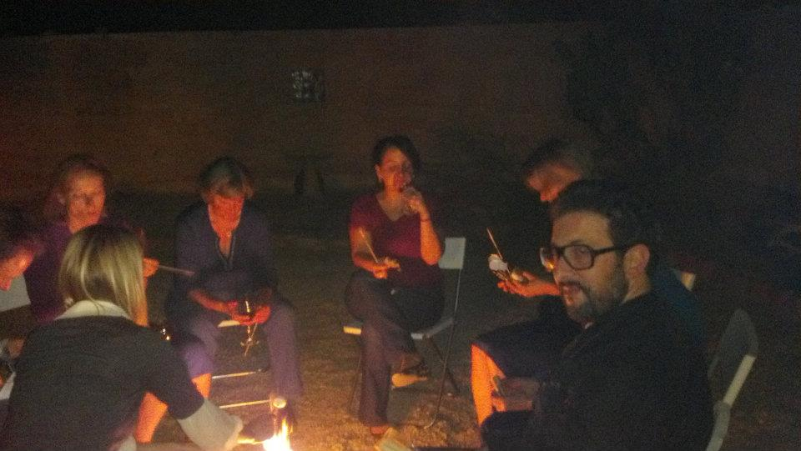

Slide 10


Slide 11
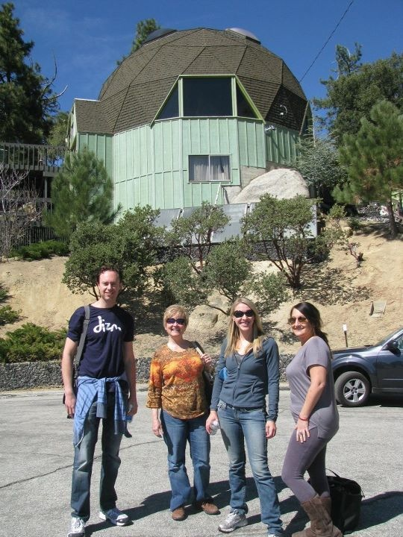

Slide 12
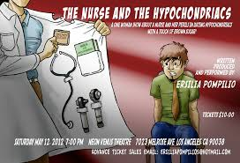

Slide 13


Slide 14


Slide 15


Slide 16


Slide 17
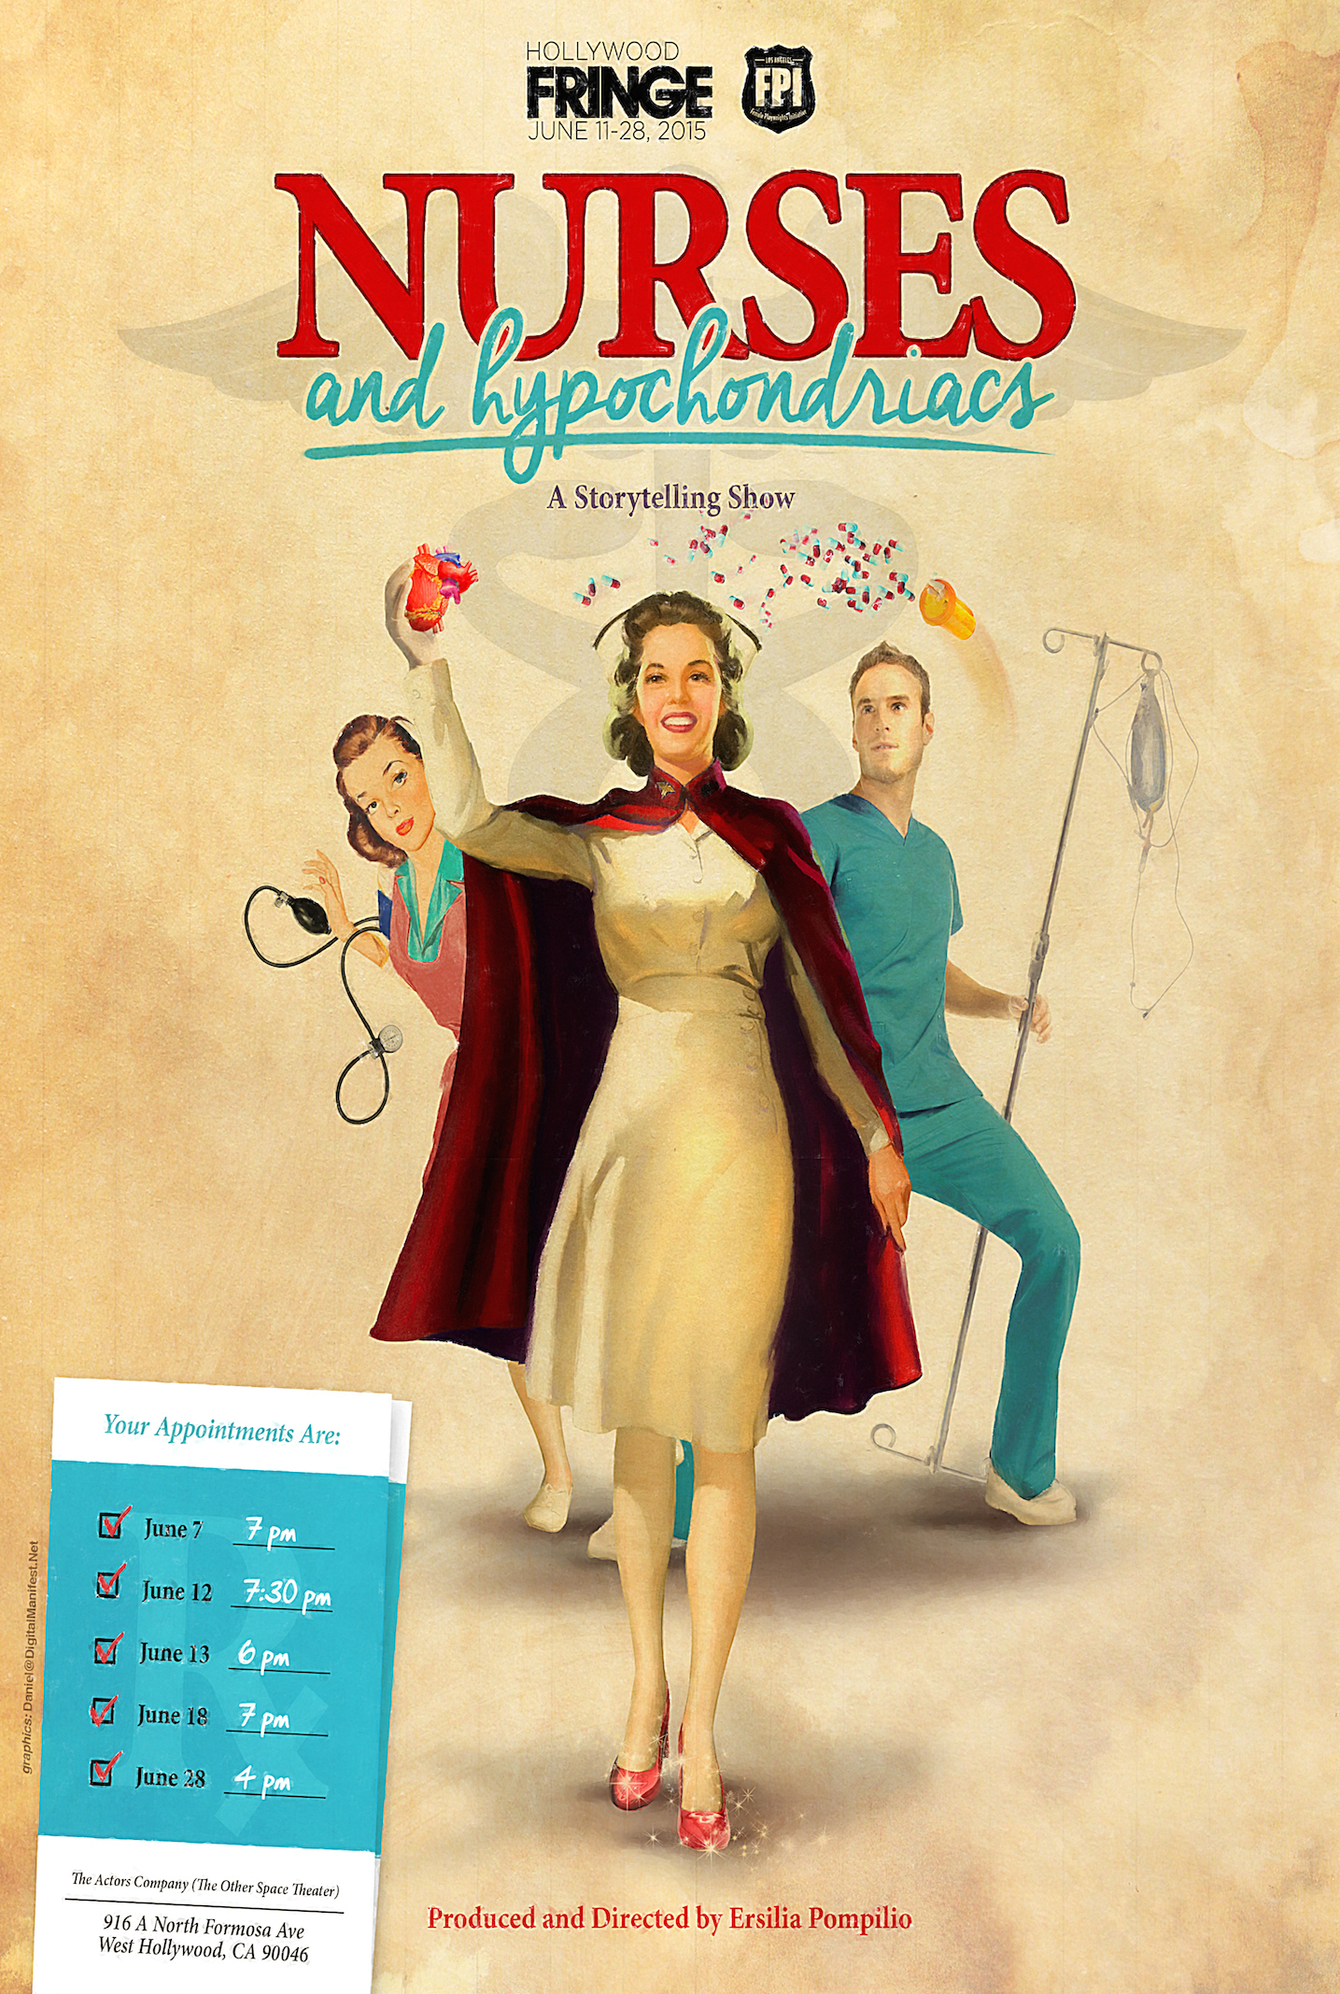

Slide 18


Slide 19

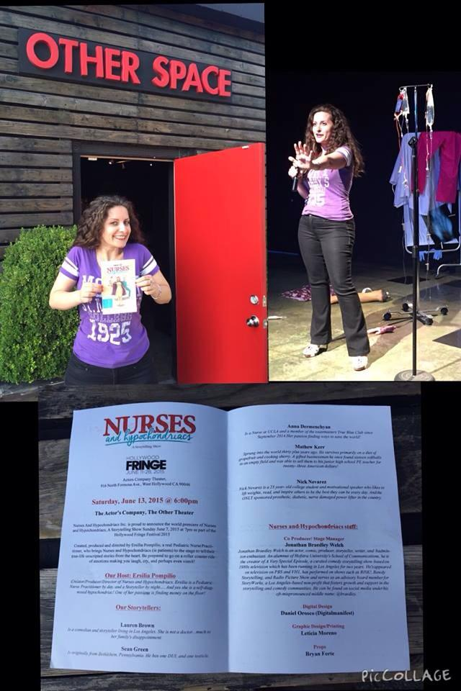
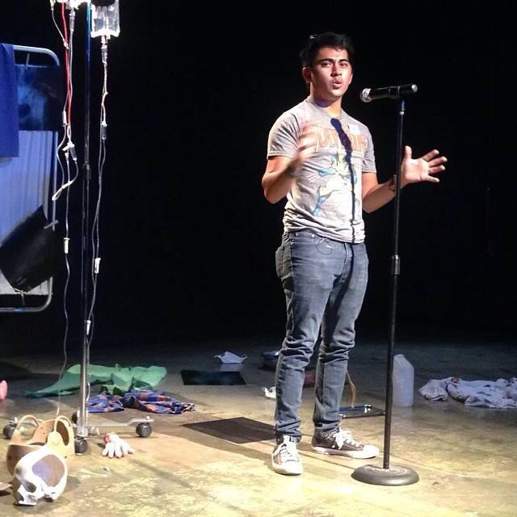

Slide 20



https://vimeo.com/157666903

Slide 21
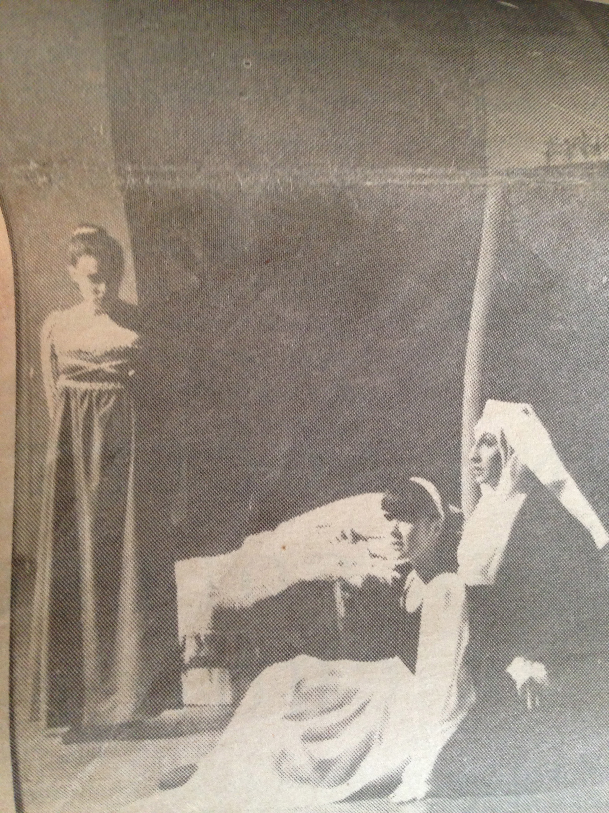

Slide 22
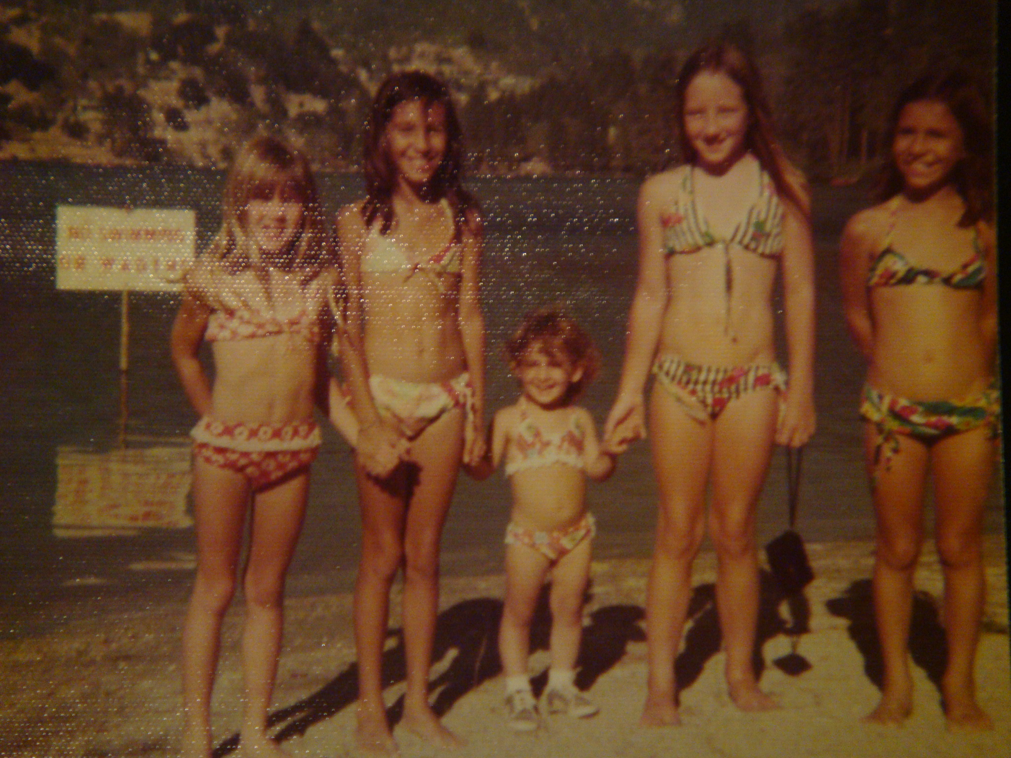

Slide 23




Slide 24
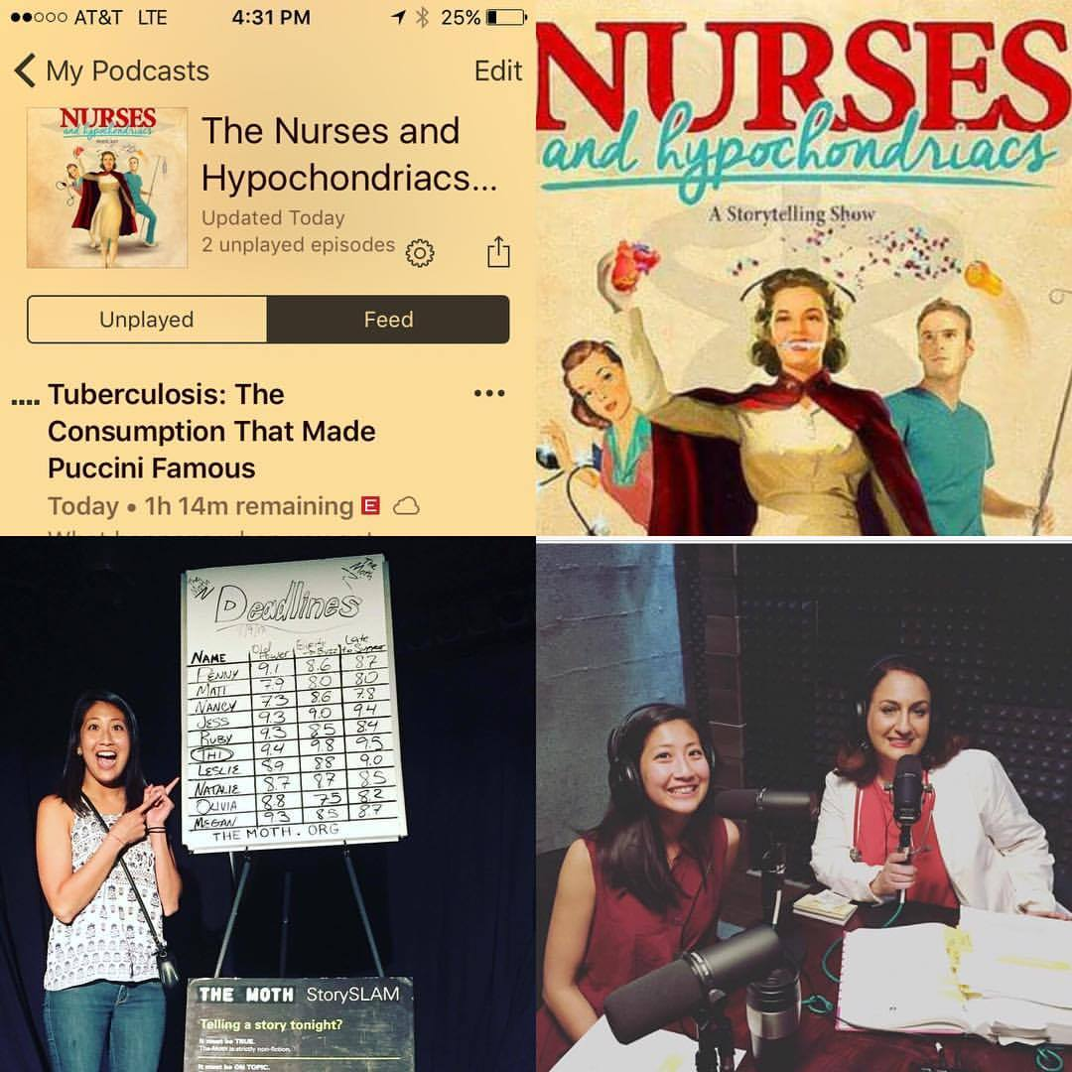

Slide 25
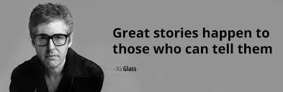

Slide 26
The Power Of Storytelling …
Increase in EMPATHY for the Storyteller
(The Empathy Project)
Therapeutic: Gives you a chance to look at an experience in a different light. The Storyteller feels “understood” and “validated.”
(When Storytellers get personal…very personal, BBC.com2016)
Helps co-workers to connect increase in work productivity
Helps people to connect in a different way other than social media
Helps you to connect to patients and families

Slide 27
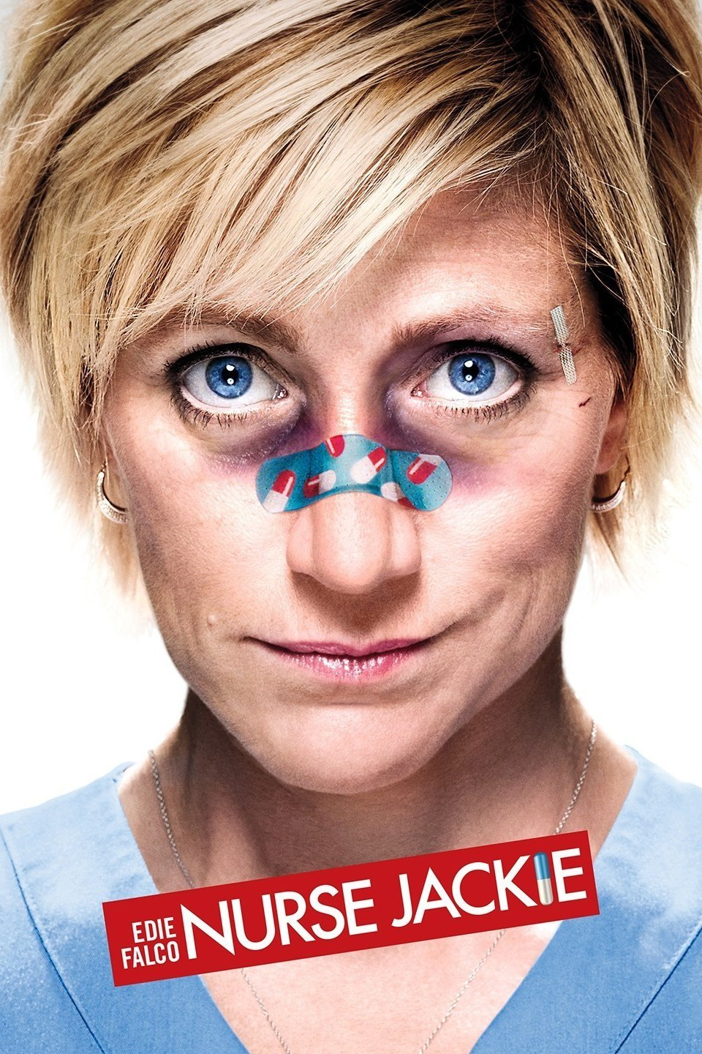
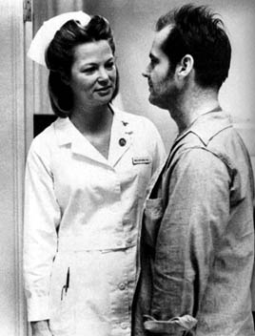

Slide 28
How To Change Perceptions Of Nurses And Patients In The Media
Do TV Nurses Represent You (Working Nurse Magazine, 2016)
Teach Nurses And Healthcare Providers How To Write.
Why Nurses Would Make Great Journalists (2017)
Most Healthcare analysts/ Journalists Have No Healthcare Experience

Slide 29
Why aren’t their more NURSE Journalist?
“Every now and then, I hear from a young person who wants advice on how to start a career as a health journalist, and I’m never able to help. It’s embarrassing ! Though I’ve been at this for a frightfully long time, I went the usual route of covering cops and zoning boards until the medical writers job opened up (thanks Irene). I don’t know if that’s even an option today. “-Felice Freyer Medical Journalist
“Among the professions surveyed by the annual Gallup honesty/ethics poll, nurses have been at the top of the list since 2001, and remain there after the latest survey conducted in 2016. Of that survey 84% of the respondents rated nurses as being very high or high as professionals who are honest and ethical.” (Gallup Pole 2016)

Slide 30

Mission: To EMPOWER Nurses & Patients
To Tell Their Stories

Slide 31
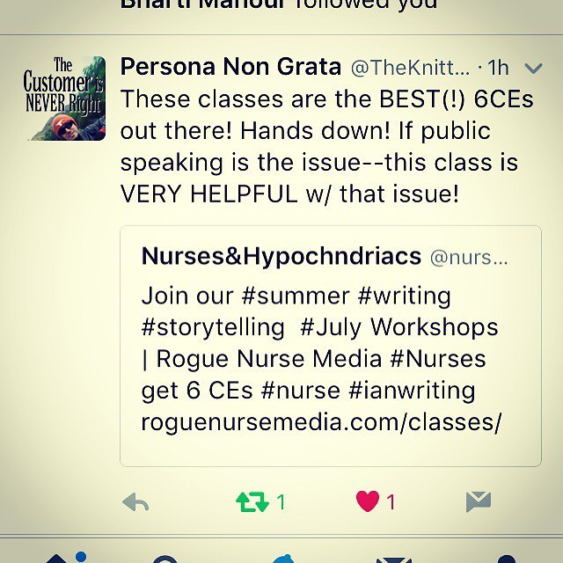

Slide 32
Common Complaints I hear from Nurses
“I have no Creative drive!”
“The only CREATIVE Nurses I know make trinkets for name badges.”
“ I’m BURNED Out !”

Slide 33
What’s going on in the Nurse Brain that is shutting down creativity?
Fear: Fear of change rooted in the brains physiology, when fear takes hold it can prevent creativity, change and success.
The amygdala controls flight or flight response, it slows down rational and creative thinking that could interfere with your ability to run.
Shuts down non essential functions like digestion, sexual desire and though processes.

Slide 34
The brain is designed so that any new challenge or opportunity or desire triggers some degree of fear. (One step can change your life, The Kaizen Way, Robert Maurer, PhD)
Nurses brains are constantly in fight or flight

Slide 35
How Fear Effects Our Patients And Families
-Pre-surgery
-Overwhelmed with hospitilisation
-Have patients express their fears
-Small goals

Slide 36
Nurses Eat Their Young
Automatically seeing new nurse as a threat
DIS-EMPOWERING
Conditioned to bullying/ Workplace Culture
We give people recognition and praise for all the wrong reasons

Slide 37
EMPOWERMENT
Stop using the phrase: “Nurses eat their young!”
Slow down
Shut off the nurse brain
Take breaks
Educate our patients
Listen
Our brain is trying to save resources and energy. We only want to give attention to something when it matters.

Slide 38
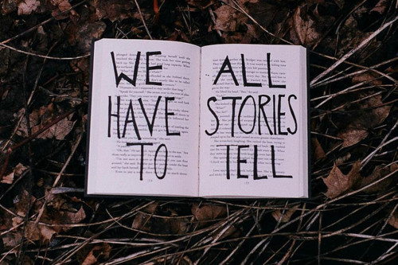

Slide 39
Art

Slide 40
Media
Express ourselves in 140 characters
Blog writing
Take a break from media exposure and technology
Media Flurries
Movies on television and what’s going on in pop culture

Slide 41
Innovative Technology
In recent years, a growing number of health care workers have been stepping up to create innovations by applying “design thinking” – a human-centered approach to innovation that was originally developed in the business world to create new products. Traditionally, hospitals were designed with input from administrators. With design thinking, the innovations come from those who actually work there, providing feedback to designers to improve the final product.
A 2016 report that looked at ways in which a health system can implement design thinking identified three principles behind the approach: empathy for the user, in this case a patient, doctor or other health care provider; the involvement of an interdisciplinary team; and rapid prototyping of the idea. To develop a truly useful product, a comprehensive understanding of the problem the innovation aims to solve is paramount.
https://www.nytimes.com/2017/08/03/well/live/design-thinking-for-doctors-and- nurses.html

Slide 42
Take Away!
Human connection begins with laughter
Listen
The best flow happens in moments of joy!
Laugh more!

Slide 43
Are You A Rogue Nurse?

Slide 44
References
Maurer, Robert, PhD.(2004) One small step can change your life, The Kaizen Way.
https://www.nytimes.com/2017/08/03/well/live/design-thinking-for-doctors-and- nurses.html
Pompilio, Ersilia RN, MSN, PNP (April, 2016 Working Nurse Magazine) Do TV Nurses Represent You?
When storytellers get personal…very personal, (BBC.com2016)

